Slide 1

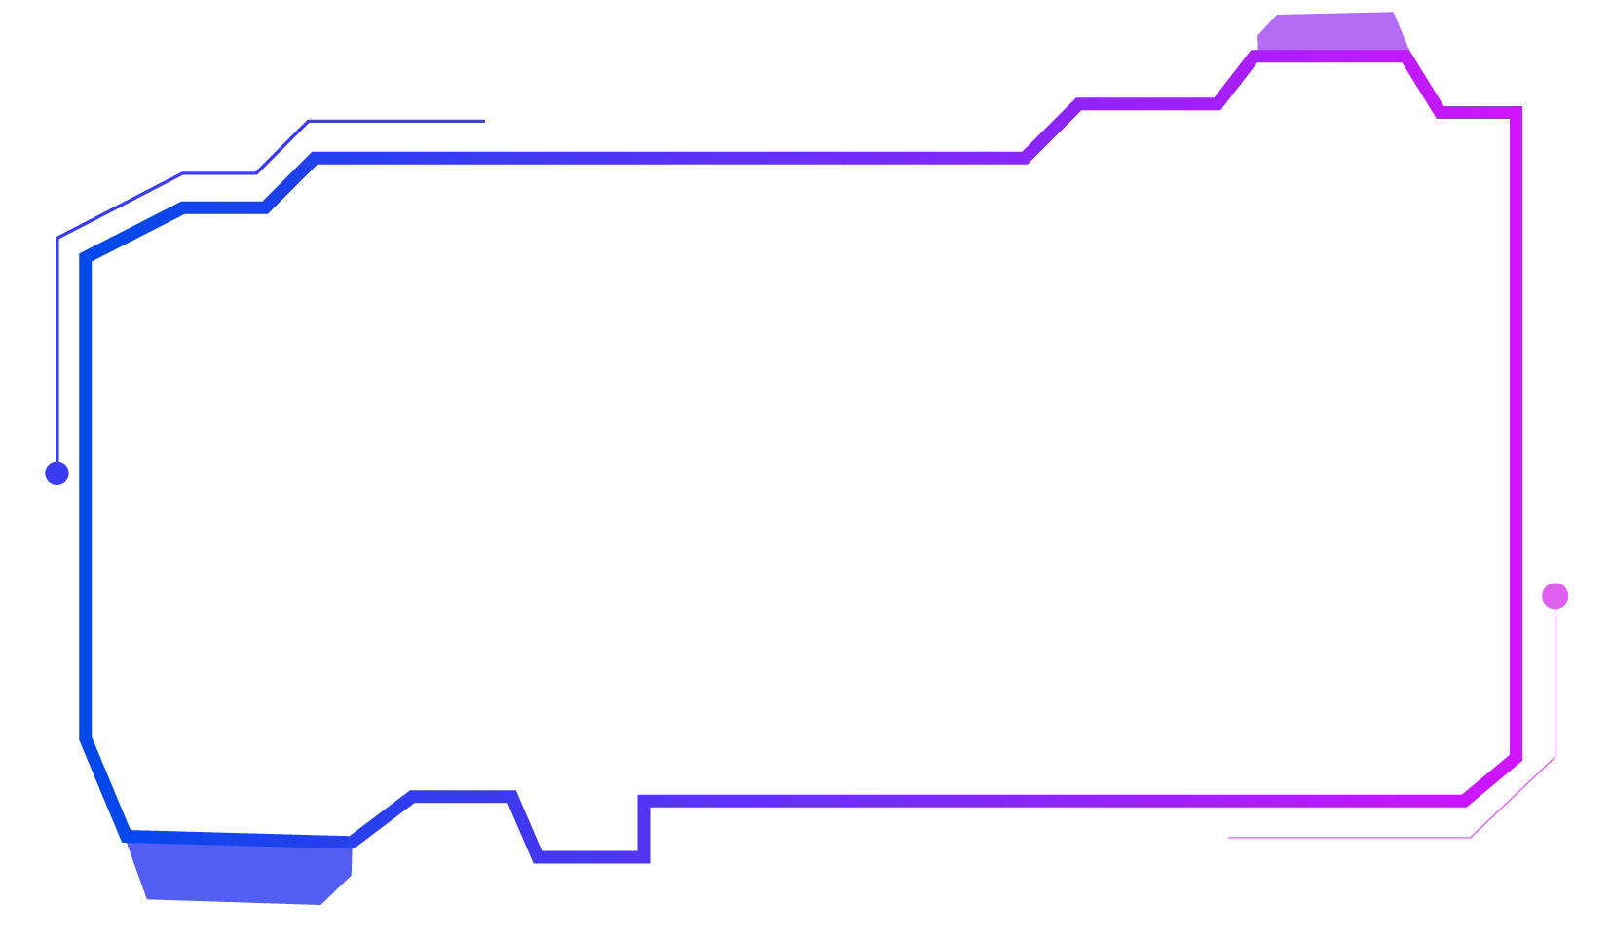
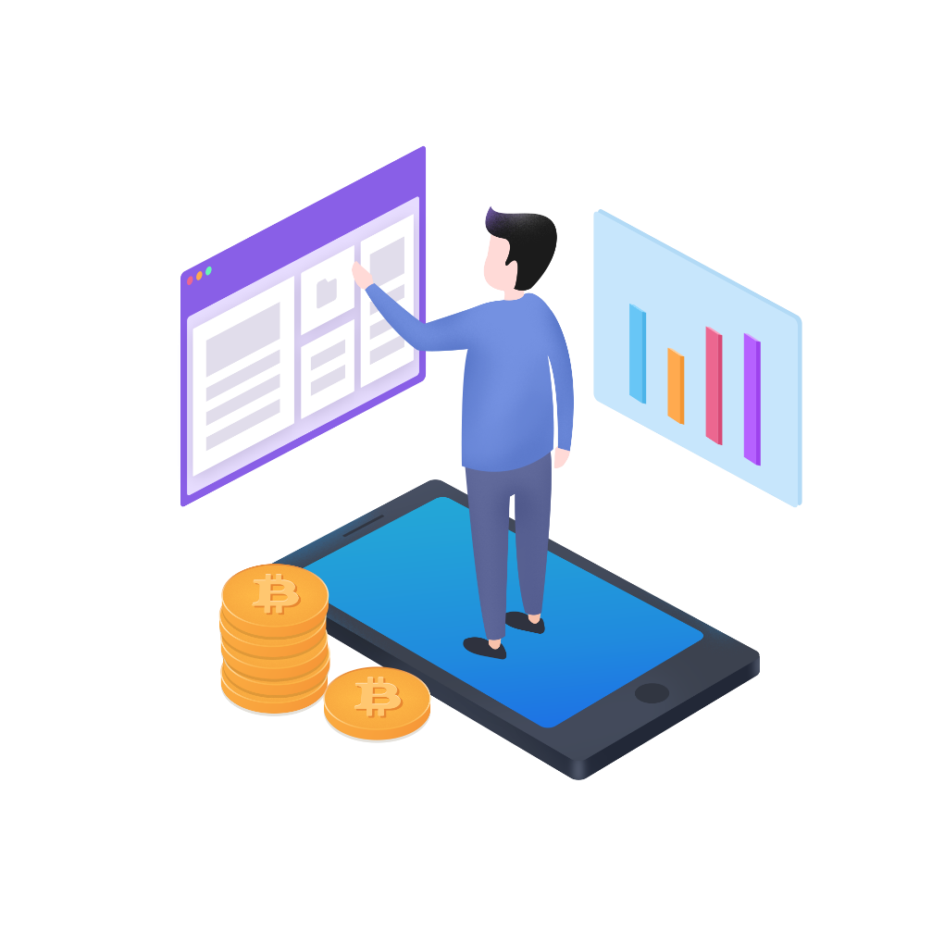
Faculty of Information and Communication Technology
PROG 102: PRINCIPLES OF SOFTWARE ENGINEERING
Mr Santigie Foday Kamara
GROUP 2
FINAL GROUP PRESENTATION

Slide 2
INTRODUCTION
ServiceConnect Platform
ServiceConnect is a digital platform that connects customers with trusted professionals. It allows users to search for services, communicate, book appointments, make payments, and leave reviews all in one place.
A Digital Public Good Connecting Customers with Professional

Slide 3

Problem Statement
Customers struggle to find trusted professionals.
Professionals have difficulty reaching customers.
Booking and payment processes are often manual.
No centralized platform for different service categories

Slide 4
Project Objectives
Build a platform that connects customers and professionals.
Specific Objectives
User registration
Service listings
Search functionality
Booking system
Payment system
Messaging
Reviews
SDG Alignment
Focus on:
SDG 8 – Decent Work and Economic Growth
SDG 9 – Industry, Innovation and Infrastructure
Helps professionals find more customers.
Supports entrepreneurship.
Promotes digital innovation

Slide 5
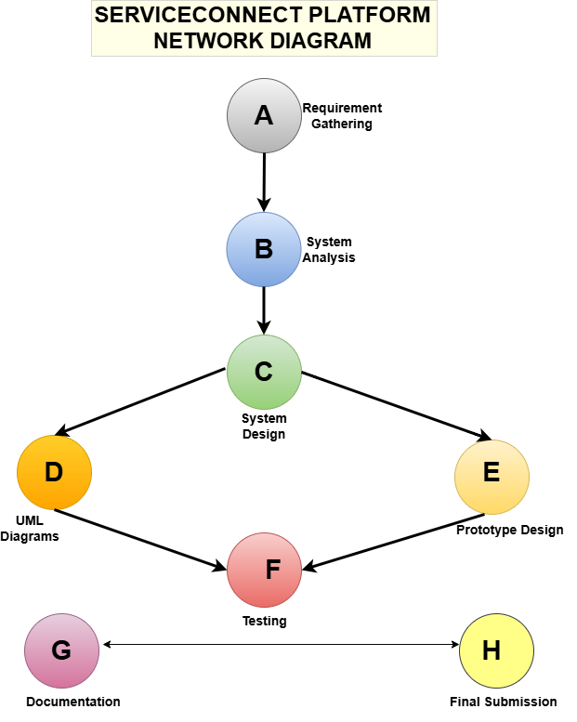
SDLC Model

Slide 6
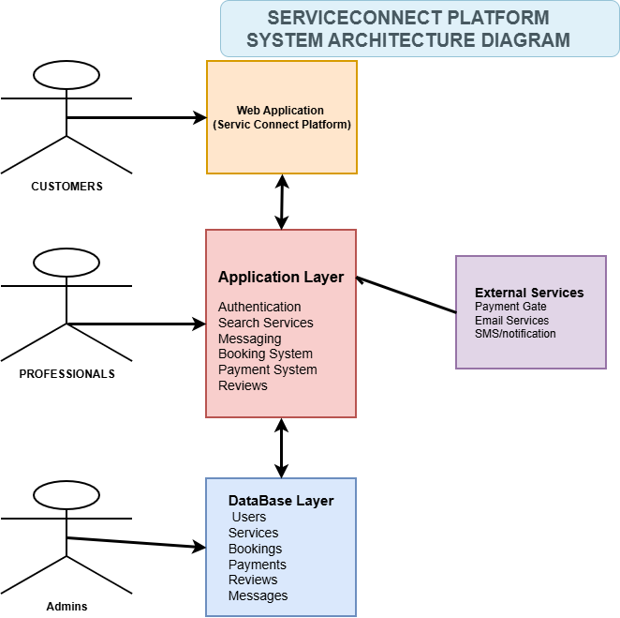
System Architecture

Slide 7
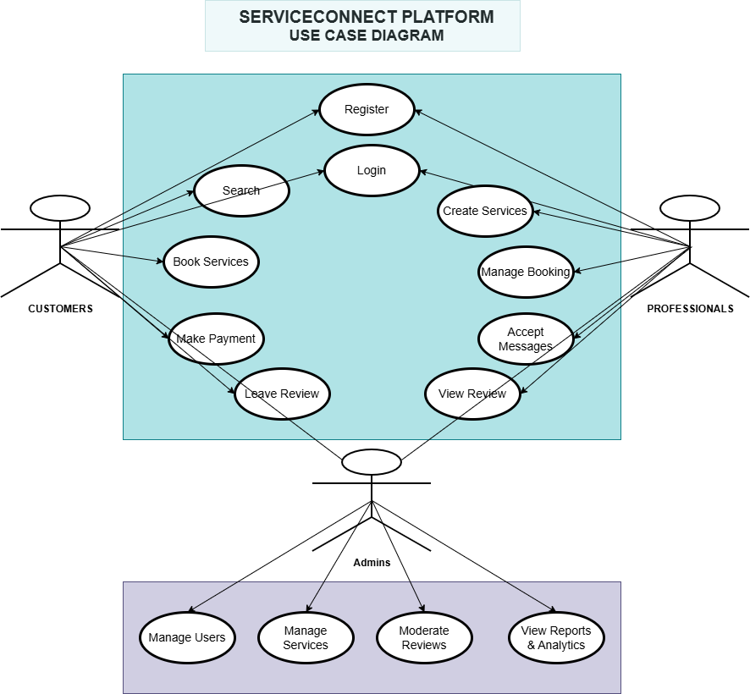
UML Diagrams

Slide 8
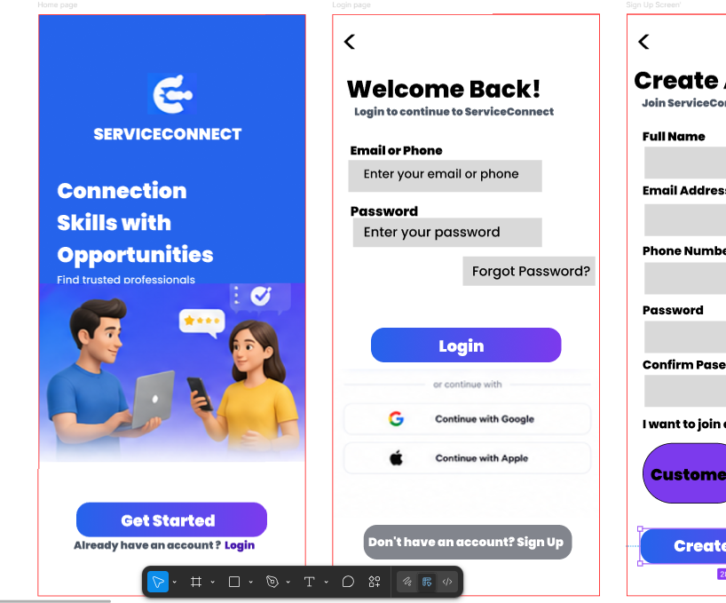
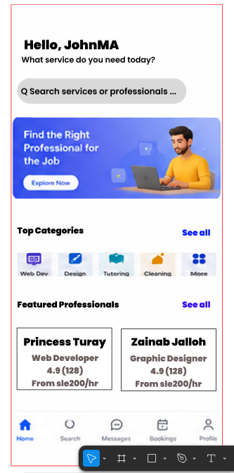
Prototype

Slide 9
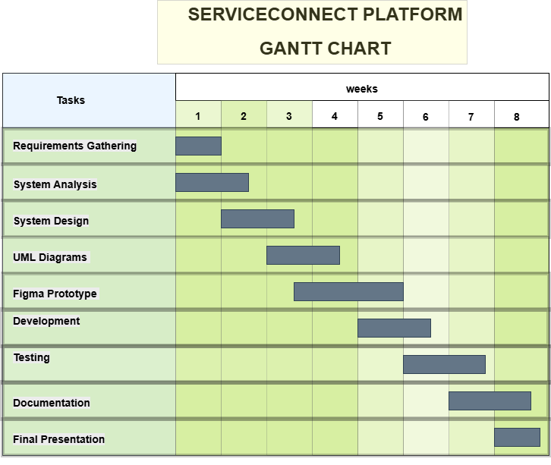
Project Management

Slide 10
Conclusion
ServiceConnect solves a real problem.
Supports SDG 8 and SDG 9.
Provides an easy way to connect customers and professionals.
Demonstrates software design principles from planning to prototype.

